Slide 1
CSTE 2103 Algorithm Design and Analysis
Fateha Khanam Bappee, Ph.D. Department of Computer Science and Telecommunications Engineering
Noakhali Science and Technology University
May 2023
Reference Book: Introduction to Algorithms”, Thomas H. Cormen

Slide 2
Divide-and-Couquer (Chapter 4)
Introduction
Recurrences
The maximum-subarray problem
The substitution method for solving recurrences
The recursion-tree method for solving recurrences
The master method for solving recurrences
Notes:
A brute force approach is an approach that finds all the possible solutions to find a satisfactory solution to a given problem. The brute force algorithm tries out all the possibilities till a satisfactory solution is not found.

Slide 3
Introduction
Recall the divide-and-conquer paradigm:
Divide the problem into a number of subproblems that are smaller instances of the same problem.
Conquer the subproblems by solving them recursively. Base case: If the subproblems are small enough, just solve them by brute force.
Combine the subproblem solutions to give a solution to the original problem.
Notes:
When arrays may not be useful?
- If the size of the structure and the data in the structure are constantly changing

Slide 4
Divide and Conquer
Analyzing divide-and-conquer algorithms:
Use a recurrence to characterize the running time of a divide-and-conquer algorithm. Solving the recurrence gives us the asymptotic running time.
A recurrence is a function is defined in terms of
- one or more base cases, and - itself, with smaller arguments.
Notes:
When arrays may not be useful?
- If the size of the structure and the data in the structure are constantly changing

Slide 5
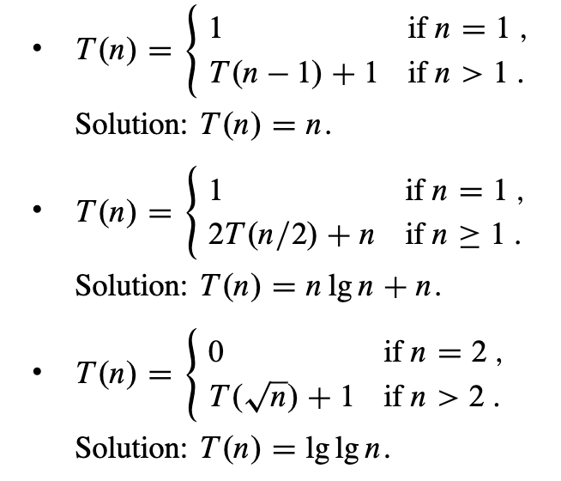
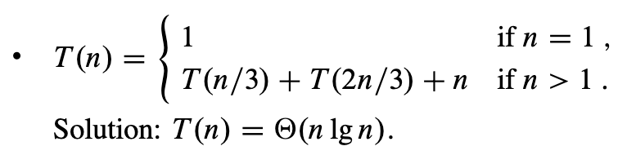
Recurrences
Example:

Slide 6
Recurrences
Methods for solving recurrences:
Substitution method – we guess a bound and use mathematical induction to prove
Master method – Memorize three cases and use them to solve recurrences of the form:
T(n) = a T(n/b) + f(n)
Recursion-tree method – converts the recurrence into tree whose nodes represent the cost incurred at various levels of recursion. We use techniques for bounding summation to solve the recurrence.

Slide 7
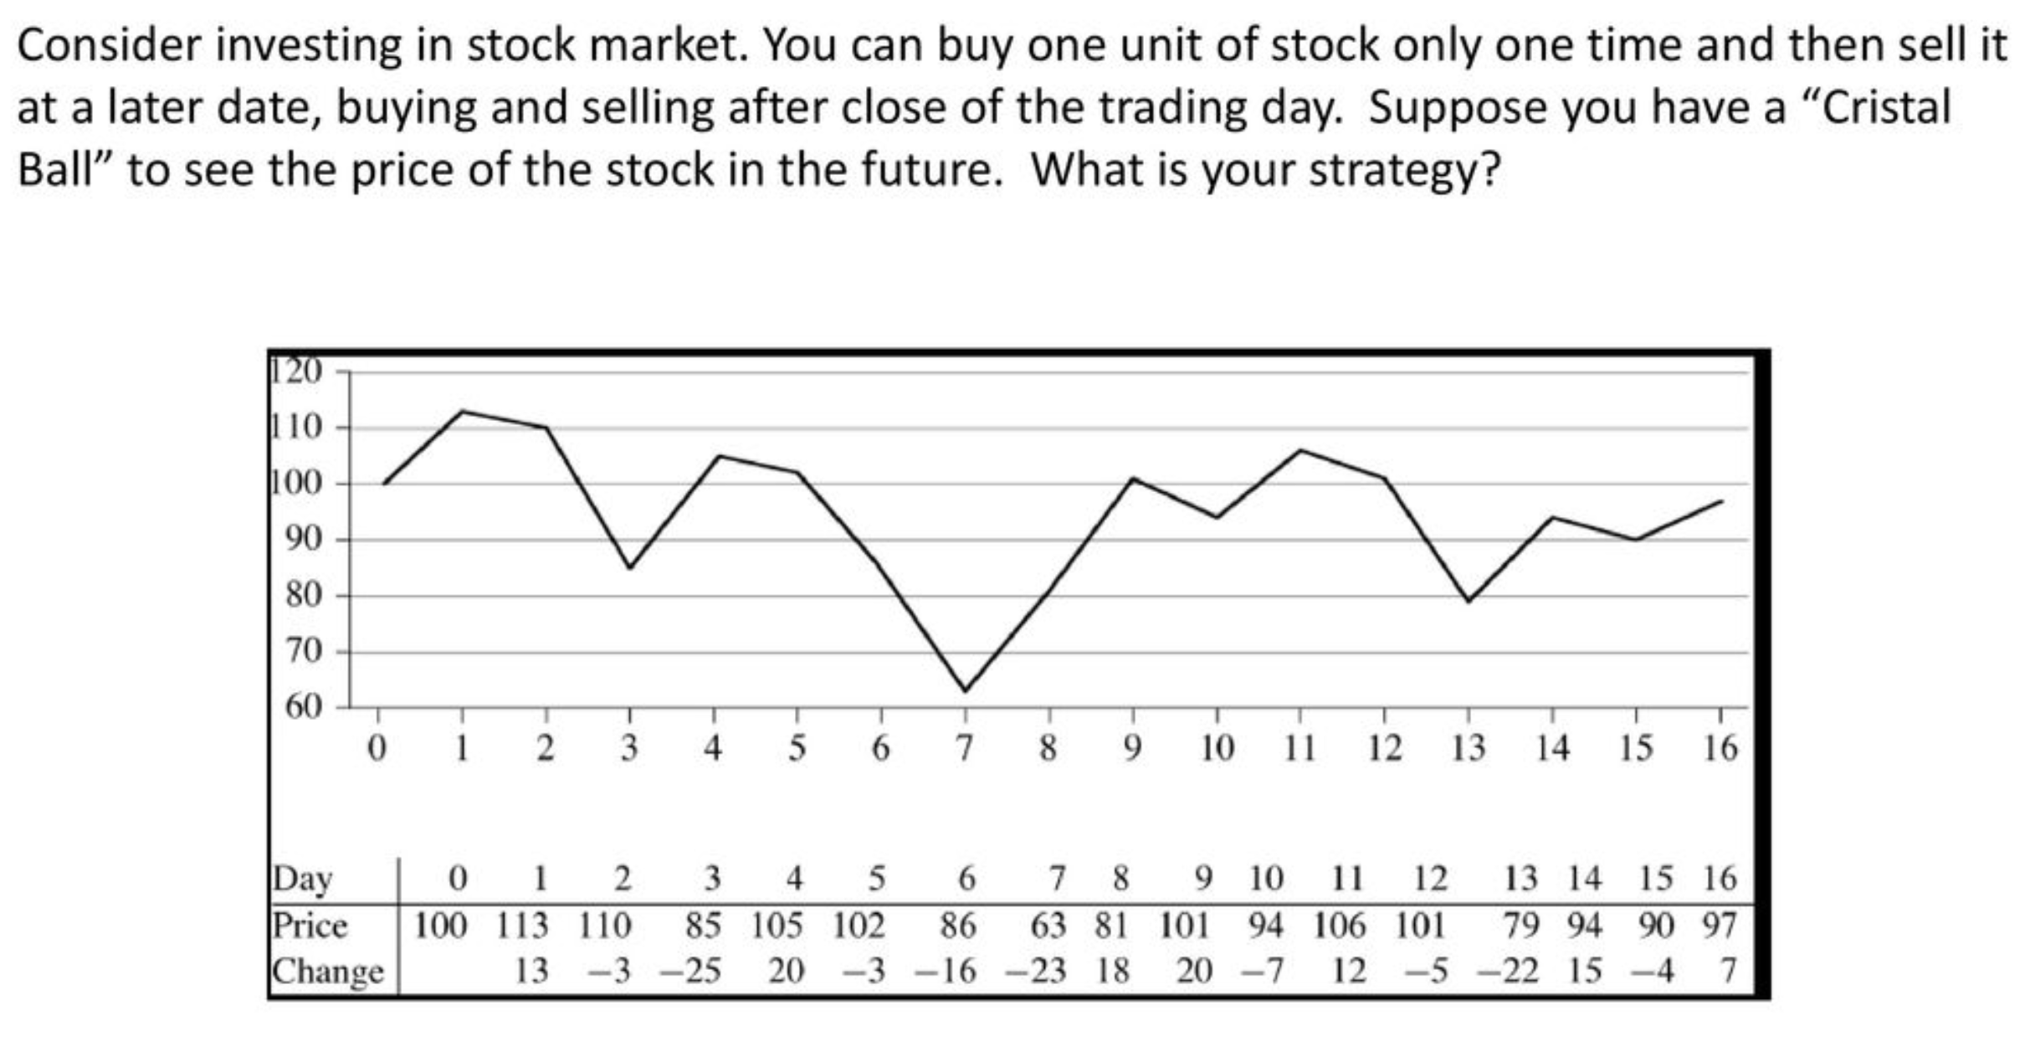
The maximum-subarray problem
Goal: Maximize your profit!

Slide 8
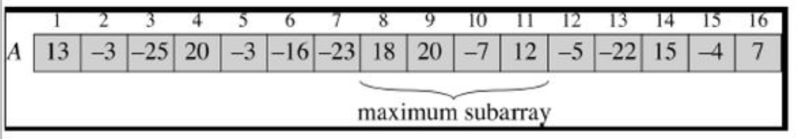
The maximum-subarray problem
We need to find the nonempty, contiguous subarray of array A whose values have the largest sum.
Solving by divide-and-conquer.

Slide 9

The maximum-subarray problem using divide-and conquer
Use divide-and-conquer to solve:
Subproblem: Find a maximum subarray of A[low …. high]
Low = 1 and high = n
Three possibilities for the location of the maximum subarray with respect to the mid-point (the divide point)
- entirely in the subarray A[low .. mid], so that low $≤i≤j≤mid,$
- entirely in the subarray A[mid+1 .. high], so that mid < i$≤j≤high$ , or
- crossing the midpoint, so that low$≤i≤mid<j≤high.$

Slide 10
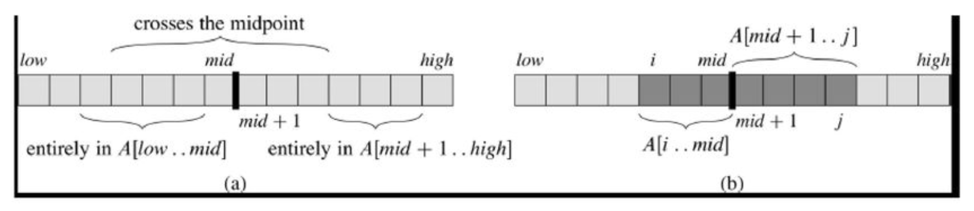
The maximum-subarray problem
Three possibilities for the location of the maximum subarray with respect to the mid-point (the divide point)

Slide 11
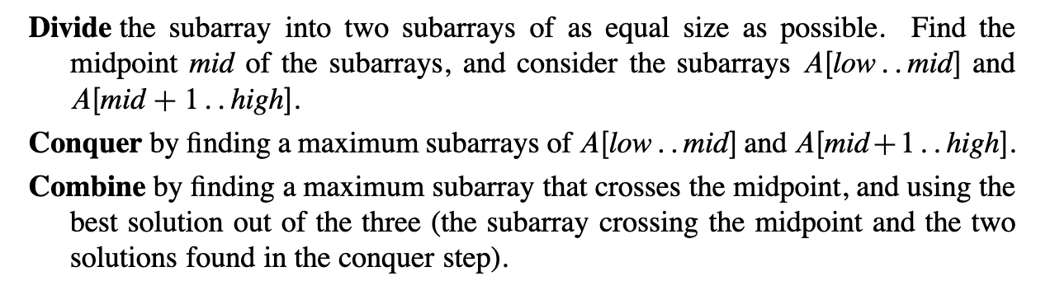
The maximum-subarray problem

Slide 12
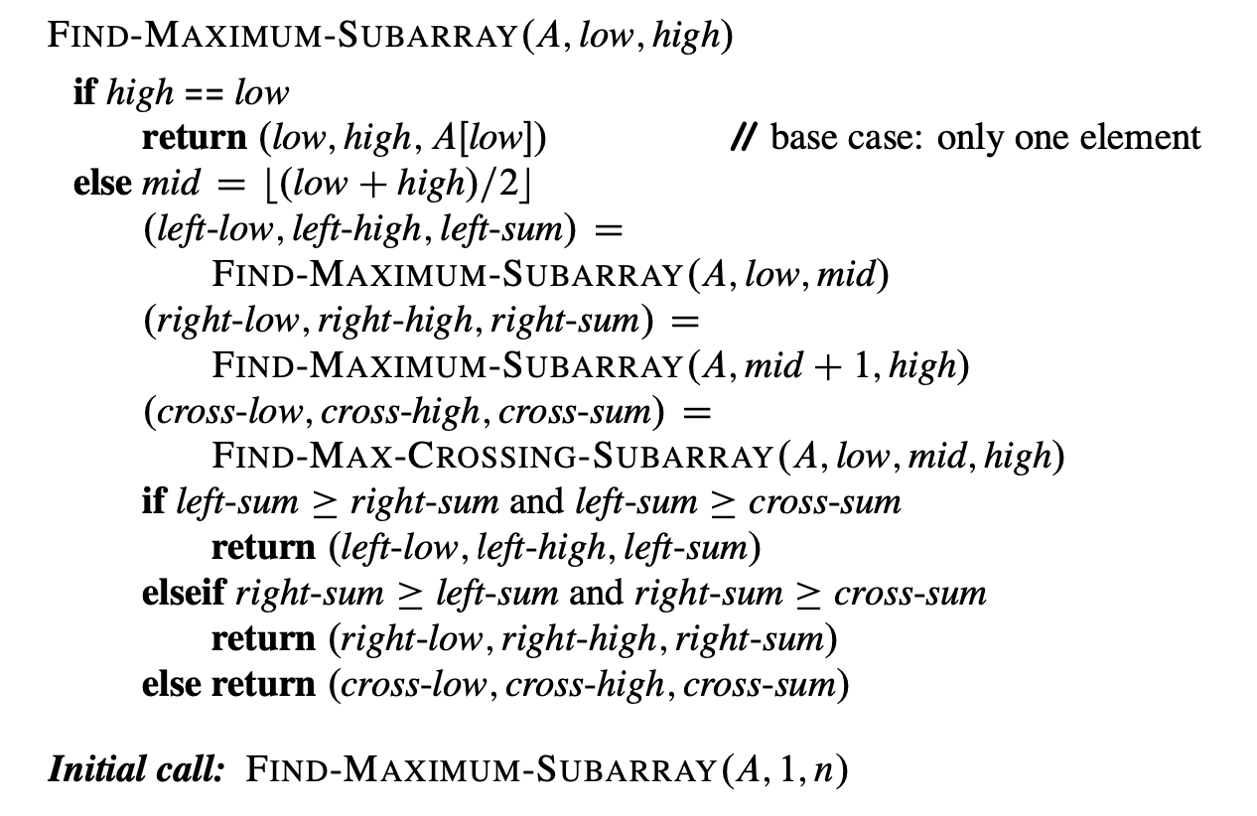






The maximum-subarray problem
$$Θ(1)$$
$$Θ(1)$$
$$T(n/2)$$
Divide-and-conquer procedure for the maximum-subarray problem:
$$T(n/2)$$
$$Θ(n)$$
$$Θ(1)$$

Slide 13
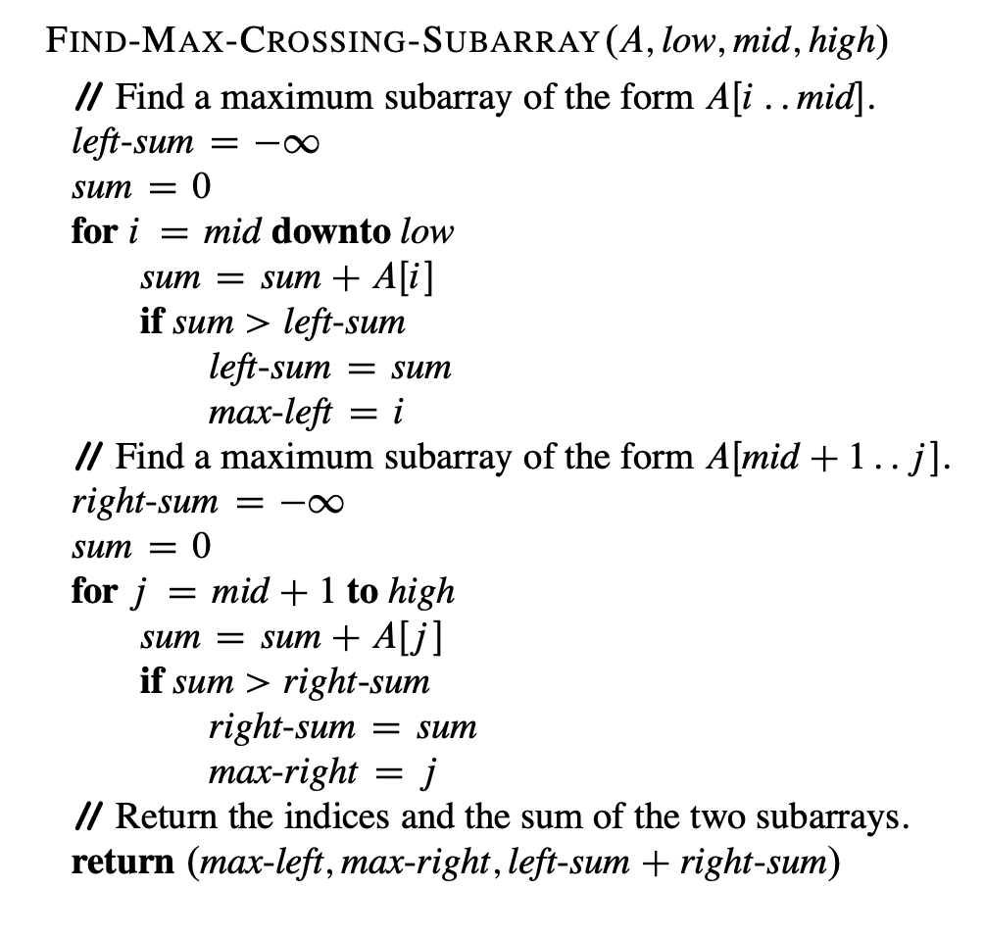
The maximum-subarray problem
Finding the maximum subarray that crosses the midpoint:

Slide 14
The maximum-subarray problem
Example:
Input: -2, -5, 6, -2, -3, 1, 5, -6
Let’s do it together in the class …….

Slide 15
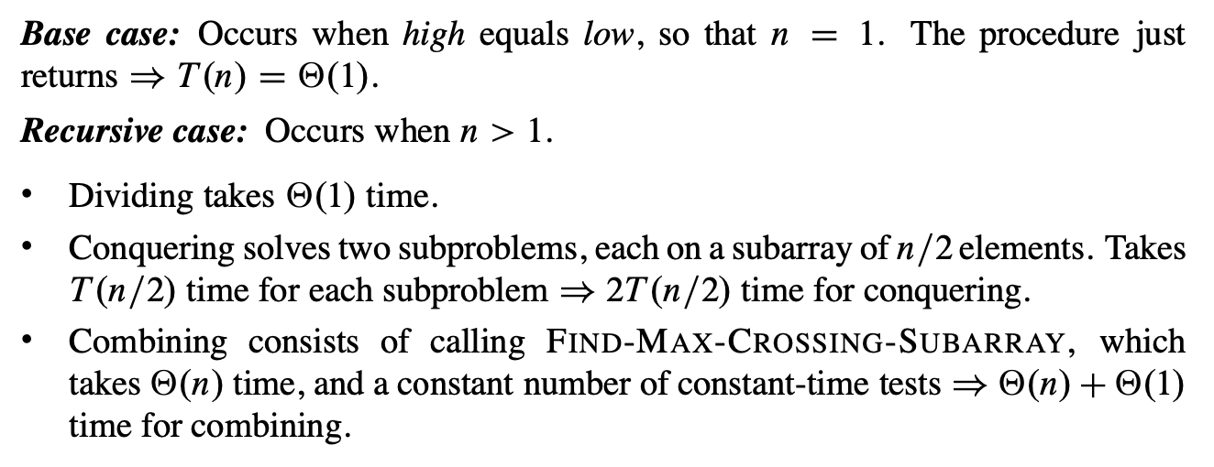
The maximum-subarray problem
Analyzing the divide-and-conquer algorithm (Section 4.1):
T(n) - running time of FIND-MAXIMUM-SUBARRAY on a subarray of n elements.

Slide 16
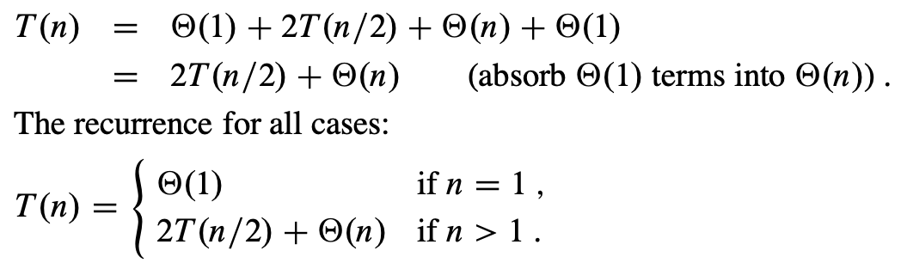

The maximum-subarray problem
Recurrence for recursive case becomes:
Solution:

Slide 17
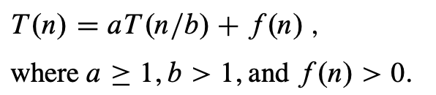






The master method for solving recurrences
Solves Recurrences of the form:
Master theorem (theorem 4.1):
- compare the function f(n) with the function
- T(n) has the following asymptotic bounds:
Case 1: If , then
Case 2: If , then (the two functions are the same size)
Case 3: If for some constant $ε>0$, and if $af(n/b)≤cf(n)$ for some
constant $c<1$ and all sufficiently large n, then $T\left(n\right)= Θ(f(n))$. ($f(n)$ is polynomially greater than $n^{\log_{b}a}$)
Asymptotically positive function

Slide 18

The master method for solving recurrences
Solve the following recurrences:
1. $T\left(n\right)=2T(n/2)+Θ(n)$
2. $T\left(n\right)=8T(n/2)+Θ(n^{2})$
3. $T\left(n\right)=2T(n/2)+n^{3}$
- Let’s do it together in the class …

Slide 19
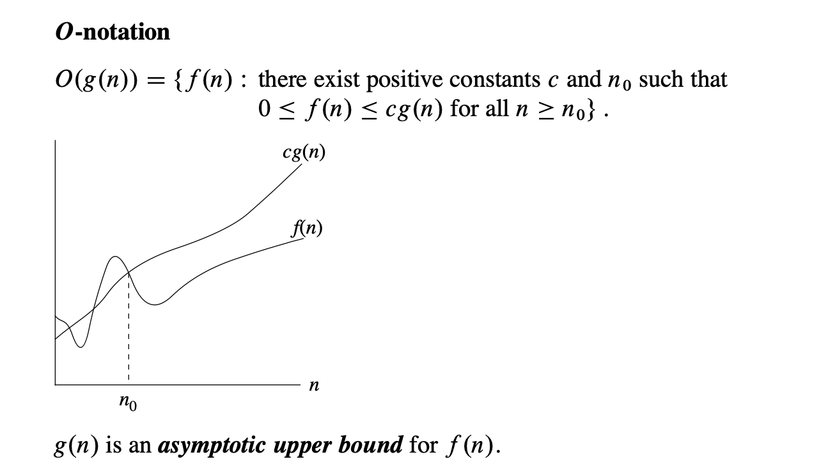
Asymptotic Notation

Slide 20
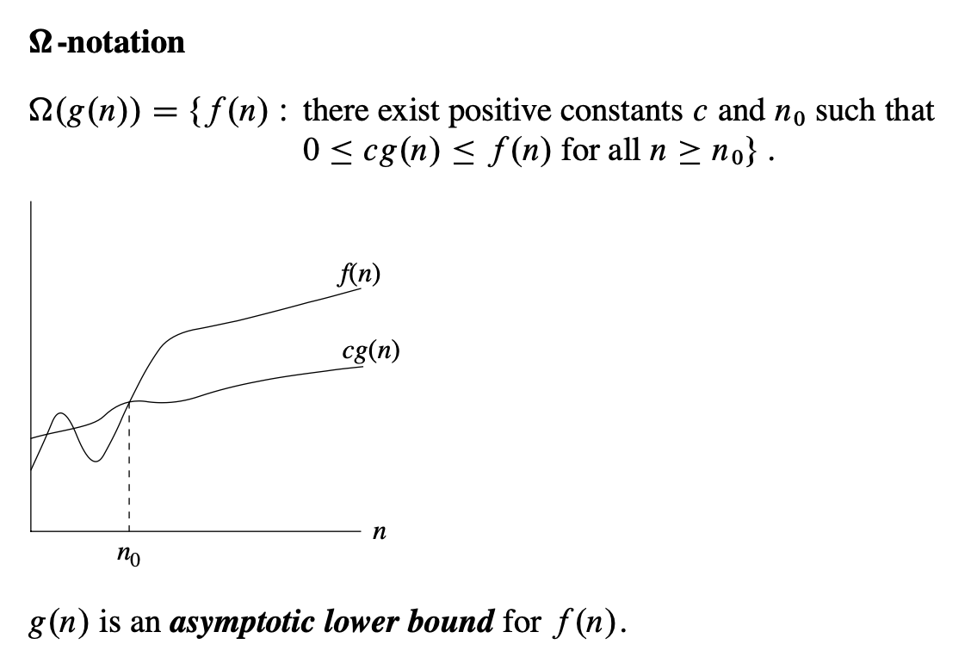
Asymptotic Notation

Slide 21
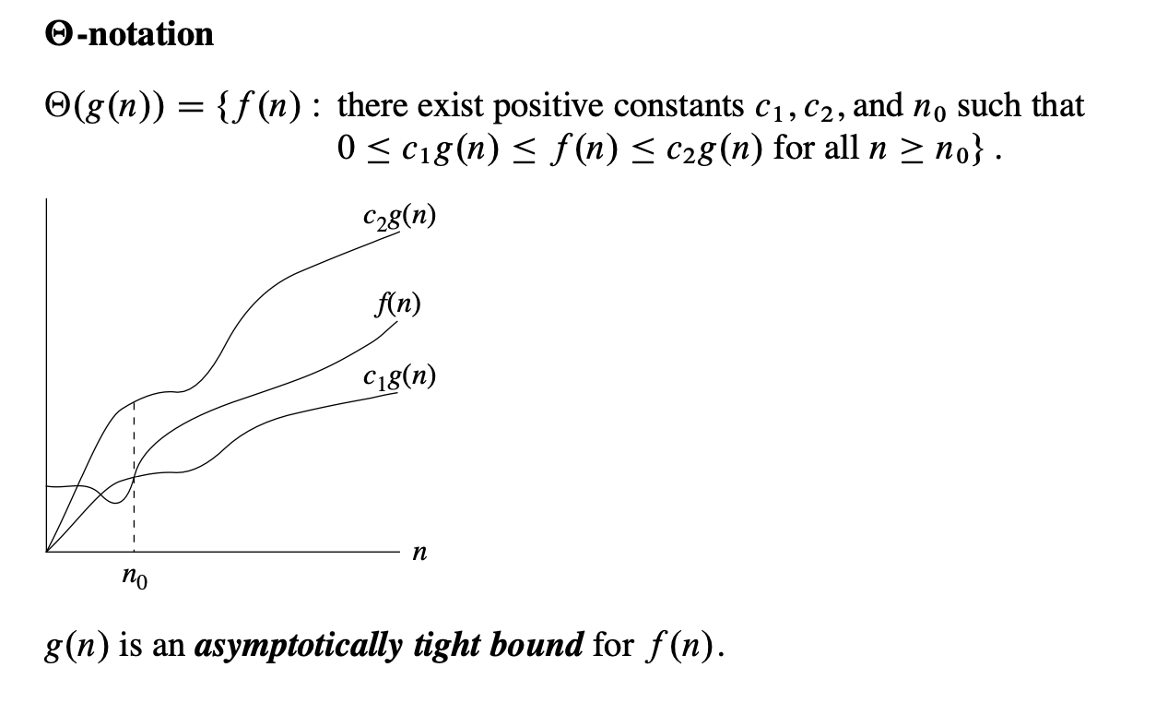
Asymptotic Notation

Slide 22
Homework!
Read Chapter 4 (Section 4.1, 4.5)………

Slide 23
Thank you
☺

